Slide 1
Up-scaling Basic Sanitation for the Urban Poor (UBSUP) in Kenya
Presentation for Public Health Officers
Version: 2.0 Last Update: August 2017

Slide 2
Presentation Road Map
What is UBSUP
Financing and Implementation
Sanitation Governance UBSUP
The UBSUP approach
UBSUP Implementation Methodology
Achievements
Organisation of sanitation services
Protective equipment for the sanitation service providers
Transportation services
Disposal and Reuse
UBSUP challenges and mitigations
Lessons learnt

Slide 3
What is UBSUP?
Upscaling Basic Sanitation for the Urban Poor.
Six-year programme (2011- 2017) with projects financed through the Water Sector Trust Fund (WSTF) and implemented by the Water Service Providers (WSPs).
GOAL: Improving living conditions by offering sustainable sanitation to residents of urban low income areas in Kenya.

Slide 4
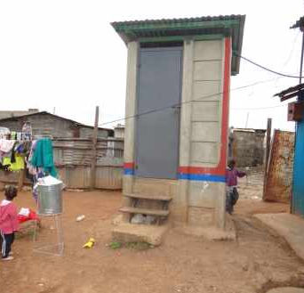
What is UBSUP?
Objectives
Provide sustainable sanitation for at least 600,000 people through new construction and rehabilitation of 60,000 toilets
Construction of decentralised treatment facilities and establishment of emptying and transportation services (private)
Develop a sanitation up-scaling concept in line with the water sector reforms in Kenya
Establishment of a monitoring system for tracking access

Slide 5
Financing Implementation
UBSUP
County Public Health Department
Government of Kenya
Technical support
WSTF
Water Sector Trust Fund
Water Service Providers
German Development Bank

Slide 6
Sanitation Governance
Ministry of Health
Policy formulation (Public Health)
Ministry of Water and Irrigation
Policy formulation (Water Sector)
National Environmental Management Authority (NEMA): Enforcement of environmental laws
National
Public Health Department
Awareness creation, hygiene education and enforcement of PH laws
Water Service Providers: Water and Sanitation Service Provision
County
Existing legal institutional framework

Slide 7
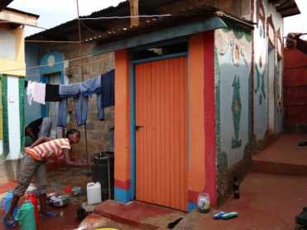
The UBSUP approach (1)
Call for proposals: Water service providers apply for the UBSUP project within their jurisdiction with estimated minimum demand of 200 toilets (Phase 1)
Social marketers promote toilet at household level (Public awareness raising and sanitation marketing)
Households/Landlords register and choose from standardised toilet designs (UDDT, Pour flush, cistern flush)

Slide 8
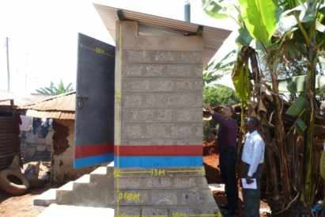
The UBSUP approach (2)
Households/Landlords contract artisans to build toilet according to standards set
Supervision of construction is done by the water service providers and field monitors from the Water Sector Trust Fund
After construction to the standards, the water service provider pays a Post-construction incentive of 20,000 Kenya Shillings per toilet door regardless of the type of toilet chosen

Slide 9
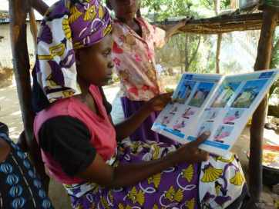
UBSUP Implementation Methodology
Rapid qualitative study to get an overview of situation in typical low income areas
Large scale quantitative study to collect data representative for low income areas
Development of technical, social and financial options covering the whole sanitation value chain
Development of household sanitation information systems
Testing of different toilet designs and piloting of the concept
Finalizing the concept based on piloting results
Up-scaling using the tested concept

Slide 10
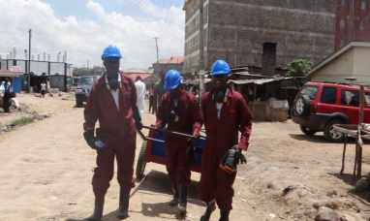
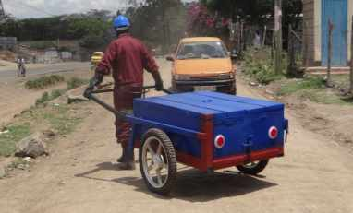
Achievements
Testing and piloting of different types of toilets completed
2,156 toilets completed during the pilot phase with 3 Water Service Providers (WSPs)
Concept established (study, sanitation systems, social marketing concept and business model)
The 1st call for proposals for up-scaling done where 40 water utilities had applied
20 projects have implemented 4,000 toilets and 7 decentralised treatment facilities (6 under construction)

Slide 11
Organisation of sanitation services
Identifying, training and registration of manual emptiers
The manual emptiers (Sanitation Teams) are identified by the Public Health Officers (PHOs)
Registration at the WSP for training (minimum of 15 people)
Theoretical and Practical training by the WSPs, PHOs, NEMA officials and SafiSan team
Certificate of training awarded to the Sanitation Team
Registration at the Department of Gender and Social Welfare
Provision of certificate copy, list of members and ID’s to the WSP
Sign lease agreement and MoU between the WSP and the group

Slide 12
Organisation of sanitation services
8. Seek authorization from Public Health Office
9. Apply for the NEMA Transportation Permit
10. WSP commissions group to begin with the emptying of the dry toilets/UDDTs
11. List of all registered Sanitation Teams will be in the WSP technical, customer care and pro-poor department
12. Clients contact the Sanitation Teams directly pay them for the services of emptying their facility

Slide 13
Protective equipment for the sanitation service providers
Overalls
Gumboots
Apron
Helmet
Respirator
Gloves

Slide 14
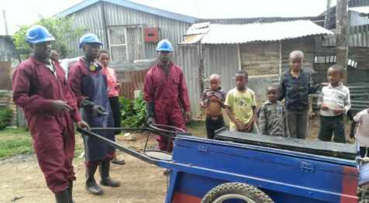
Transportation equipment for the sanitation service providers
2 modes of Transportation:
Motorised
Non-motorised

Slide 15
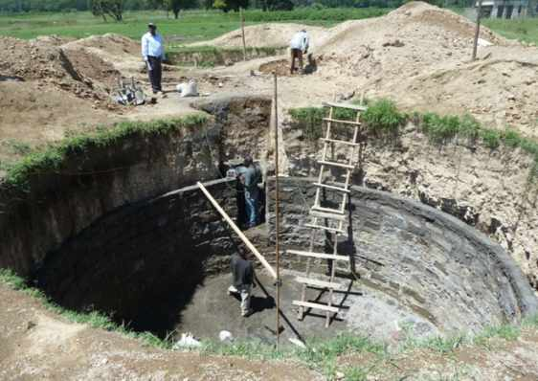
Disposal and Reuse
Existing Waste Water Treatment Plants
Newly constructed decentralised treatment facilities
Reuse a possibility once pathogen results are released by University of Nairobi

Slide 16
UBSUP – Challenges and mitigations
Challenges | Mitigation
1. Inability of landlords to cover investment costs of building the toilets to completion | Development of affordable toilet options Timely payment of subsidies
2. Slow initial uptake | Robust sanitation marketing and prompt payment of the 1st subsidies

Slide 17
UBSUP – Challenges and mitigations
Challenges | Mitigation
3. Less attention to hand washing facilities | KonoSafi a comic book was produced to target children Posters put in every toilet Hand washing facilities as a pre-requisite for payment of post-construction incentive
4. Reluctance of landlords to provide copies of land ownership documents 5. Slow construction of the decentralised treatment facilities | Any basic proof of ownership is acceptable since households/landlords invest their own money Prequalifying contractors who have built such facilities before

Slide 18
UBSUP – Challenges and mitigations
Challenges | Mitigation
7. Process of land acquisition for the decentralized treatment facilities takes too long | Proof of land ownership has to be shown by WSPs during applications
8. NEMA licensing for the construction consumes a lot of time | WSPs to prepare Environmental Impact Assessment at project inception

Slide 19
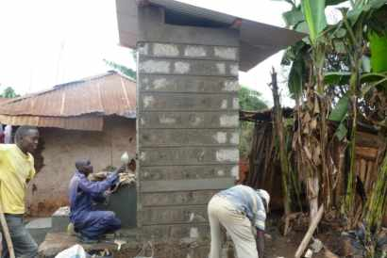
Lessons learnt
Water service providers are willing to engage in household on site sanitation if a proper concept is put in place
To achieve progress in onsite sanitation, one has to go beyond awareness creation and build infrastructure
Timely payment of subsidies by the water service providers is crucial for demand creation (confidence)
Enforcement of the Public Health Act by County Health Officers is necessary

Slide 20
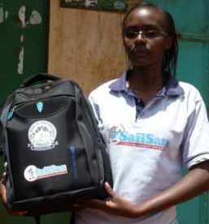
Lessons learnt
You can upscale without perfect policies and master plans in place
For up-scaling, low cost decentralised solutions are key (reaching more people at less per capita cost)
It is possible to address the entire sanitation value chain
The permanent presence of social marketers and community health workers is crucial
The county governments play a key role in ensuring project acceptability

Slide 21
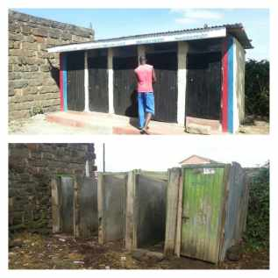
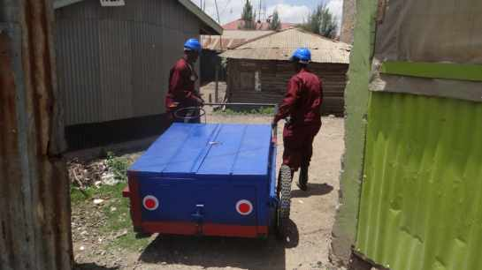
Thank you

